Slide 3


Moisés Tavira
K2
Senior Technical Specialist
http://ww.k2.com
@moituit

Slide 4

Conviértete en el héroe de la productividad de tu empresa: Construye apps híbridas con SharePoint 2013 y Office 365

Slide 5



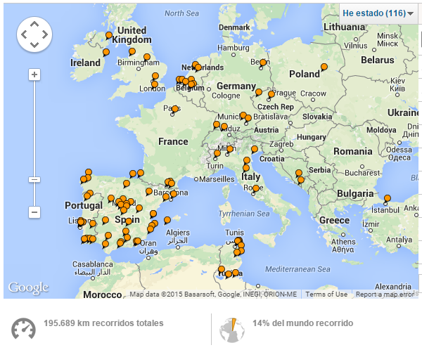
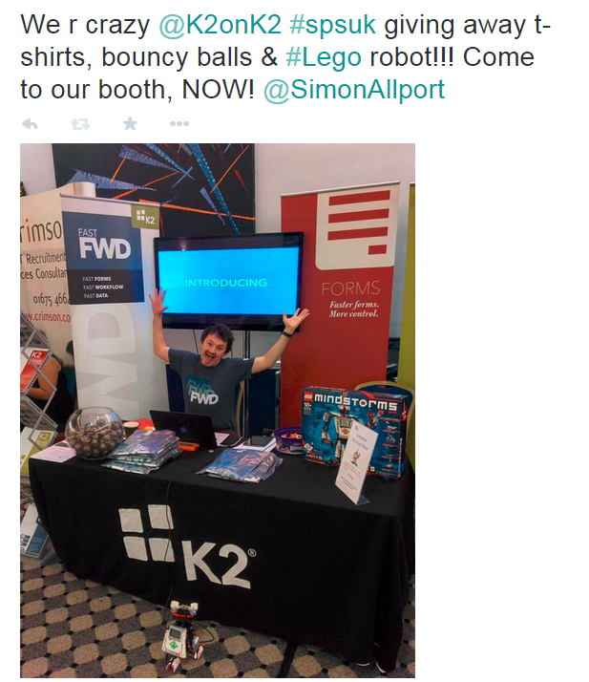





Sobre mi
@Moituit
Notes:
Me ☺

Slide 6

¿Quieres ser un héroe?

Slide 7
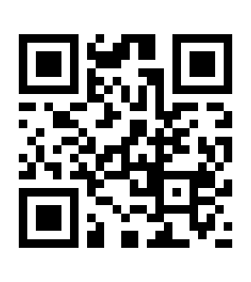
¿Qué héroe quieres ser? http://tinyurl.com/Heroes

Slide 8
Resultados

Slide 9
Los tres pasos para ser un héroe
Dile “Yes, we can!” a tu jefe
Termina el proyecto a tiempo
Haz que cosas complicadas parezcan sencillas

Slide 10



Y tu compañero dice…

Slide 11

Todo superhéroe tiene un villano… o varios!
No code
Cloud
Seguridad
Colaboración
Hibrido?
Mobile
Office 365
Apps

Slide 12

¿Cómo lo hago?

Slide 13

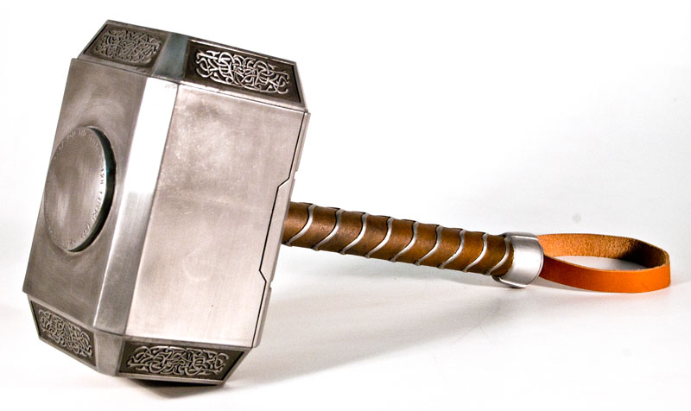
Te vamos a dar una ayuda…

Slide 14





Easily bridge cloud and people
Bridge cloud and on-premises easily
Empower more people to solve business problems with apps that include forms, workflows and access to information
Unlock mobile potential inside and outside organizations
Notes:
This is what we want?

Slide 15
¿Es eso posible?

Slide 16
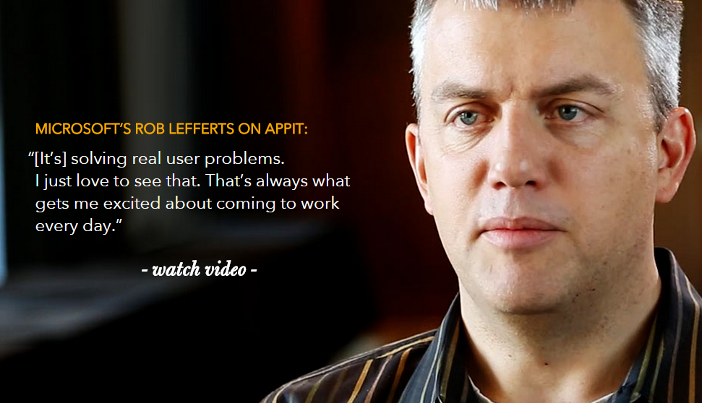
Otros héroes lo han conseguido antes

Slide 17


Slide 18

Recluta al mejor equipo

Slide 19




Recluta al mejor equipo

Slide 20

Forms: Un interfaz que mola

Slide 21


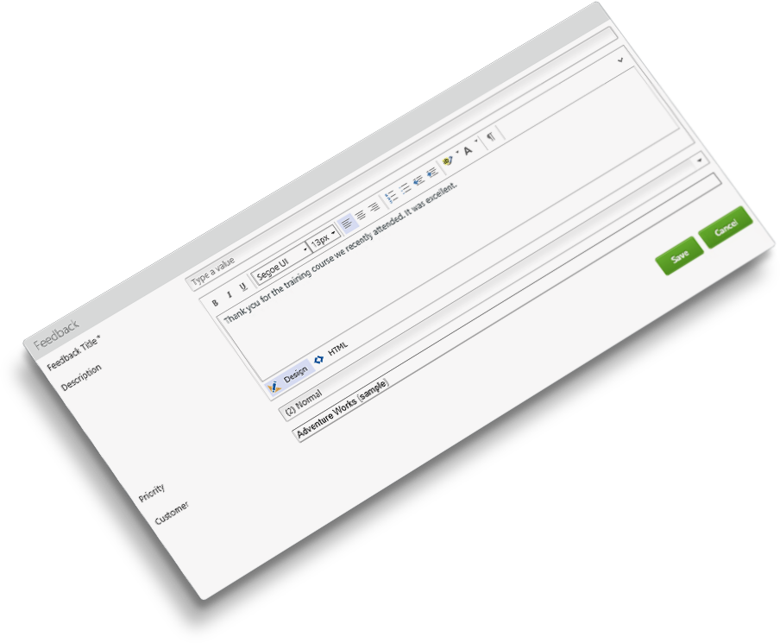
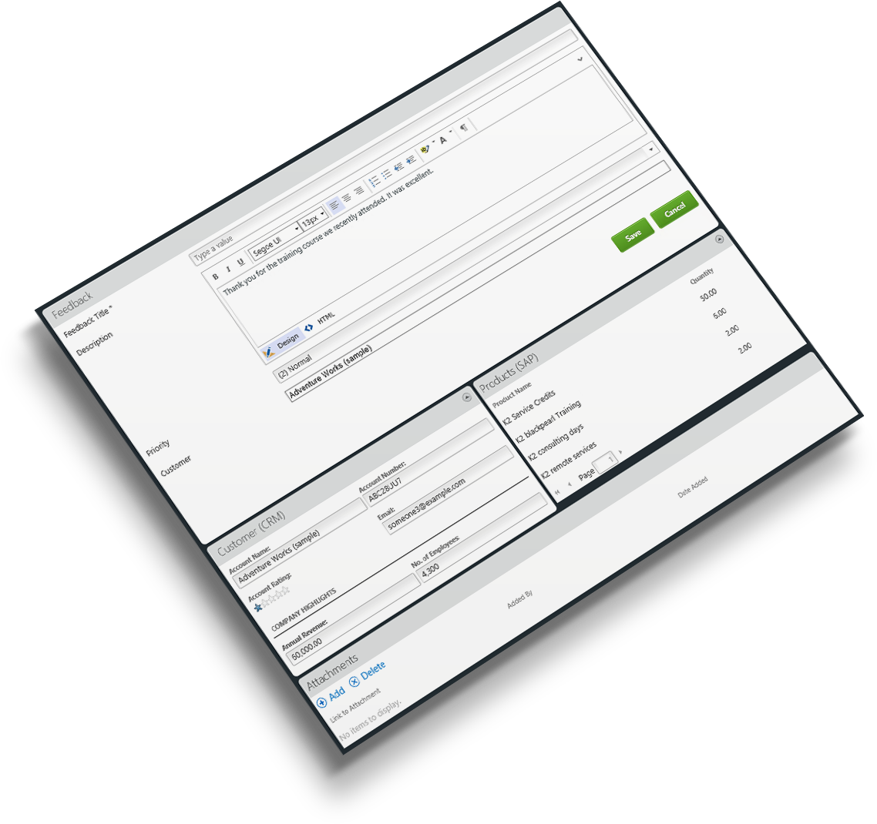

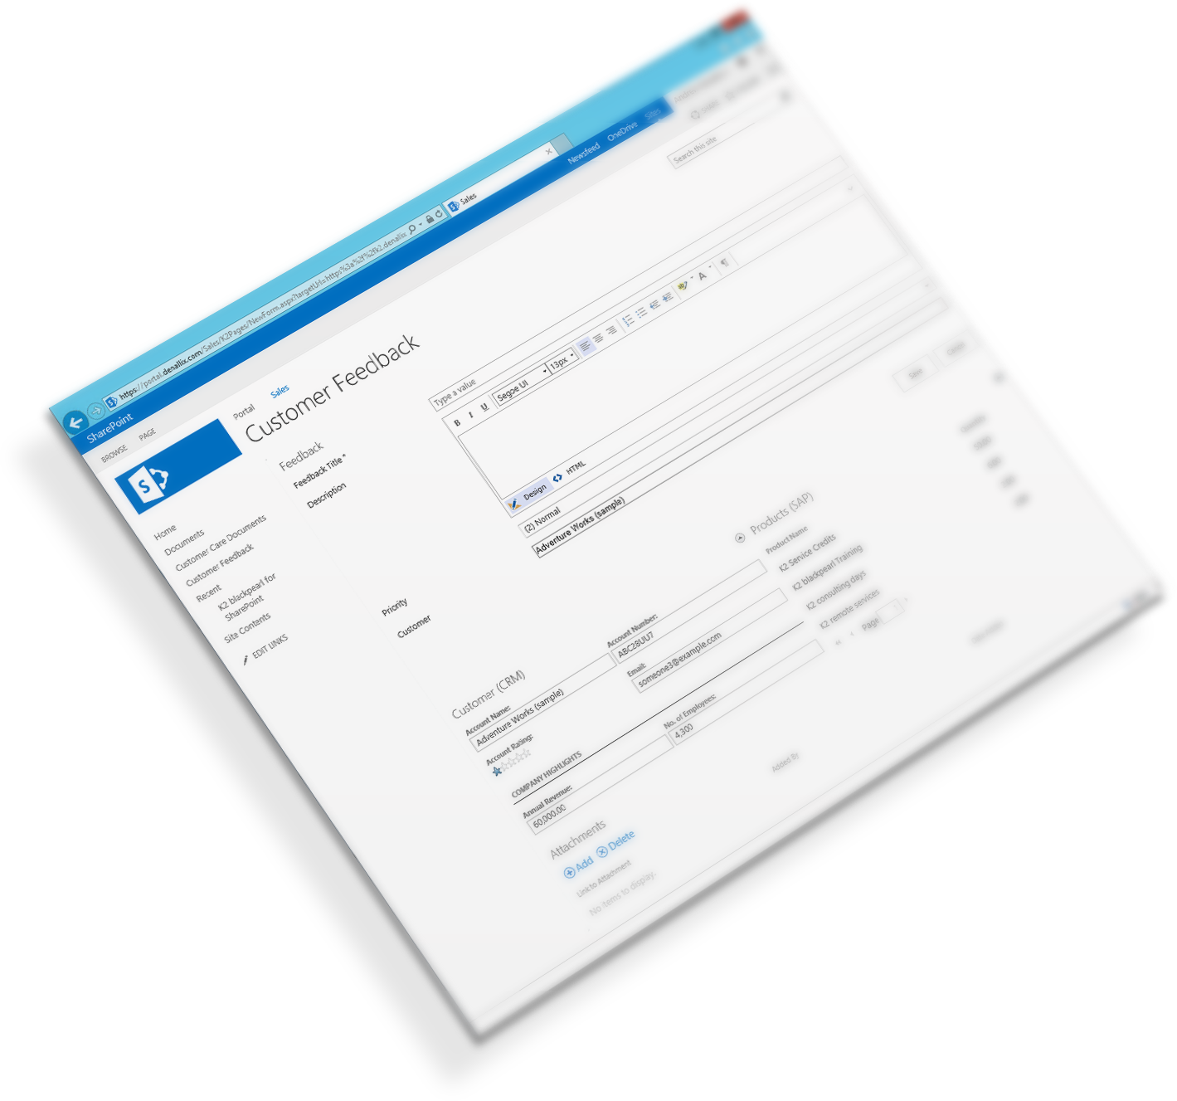

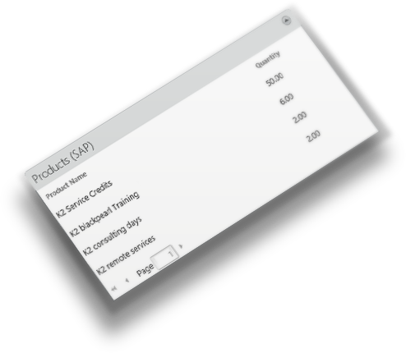



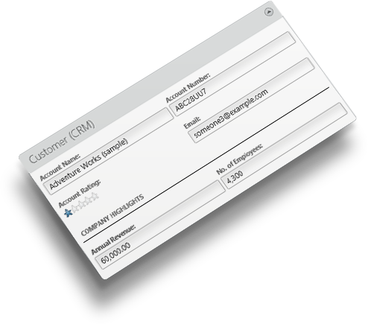


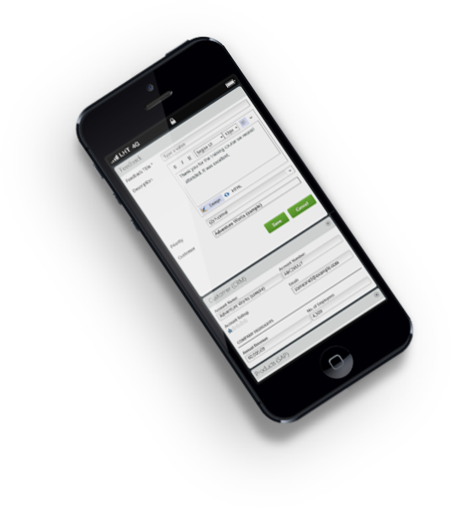




One form, multiple reusable views and data sourced from across the enterprise:
and many more.
Go Mobile
Stand-alone or seamlessly integrated inside solutions like SharePoint
Notes:
K2 smartforms enable you to create forms which are hosted in your existing applications like SharePoint, Dynamics CRM, SalesForce.com or your own custom web sites or applications
(click) Or run as standalone forms
(click) Re-usable
Create re-usable views on information from one to many line of business systems which can be incorporated into all your business forms. Using information from line-of-business systems and external data sources is easy with K2’s out of the box connectors including SharePoint, Dynamics CRM, SQL Server, Oracle, SAP, Salesforce.com, Web Services and more.
Build with rules
You don't need code to create forms that respond to user input and capture information correctly. K2’s forms rules framework enables your forms to work the way you want them to.
(click) Go mobile
In todays world we are not always in front of our PC K2 smartforms can be accessed on mobile devices for when you are on the go

Slide 22

Workflow: Asigna tareas a los especialistas

Slide 23

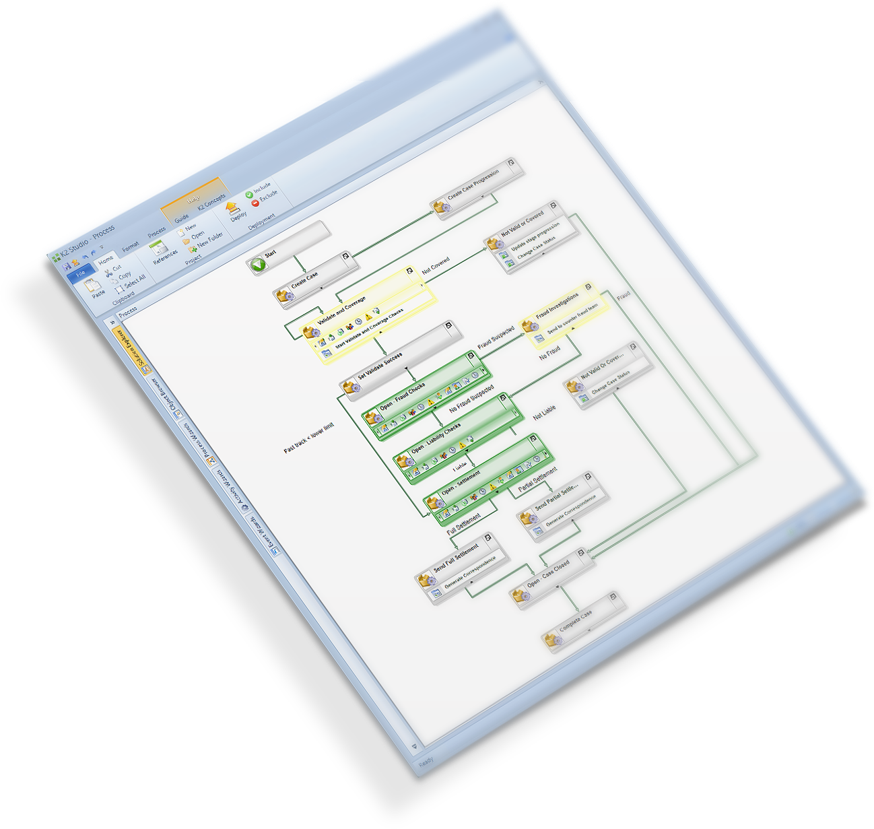
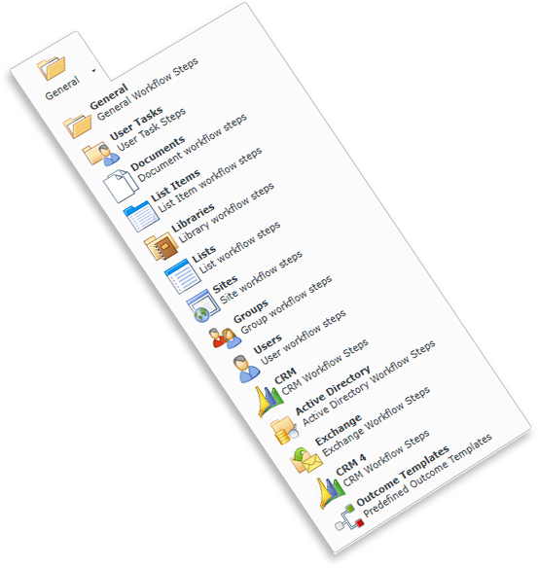
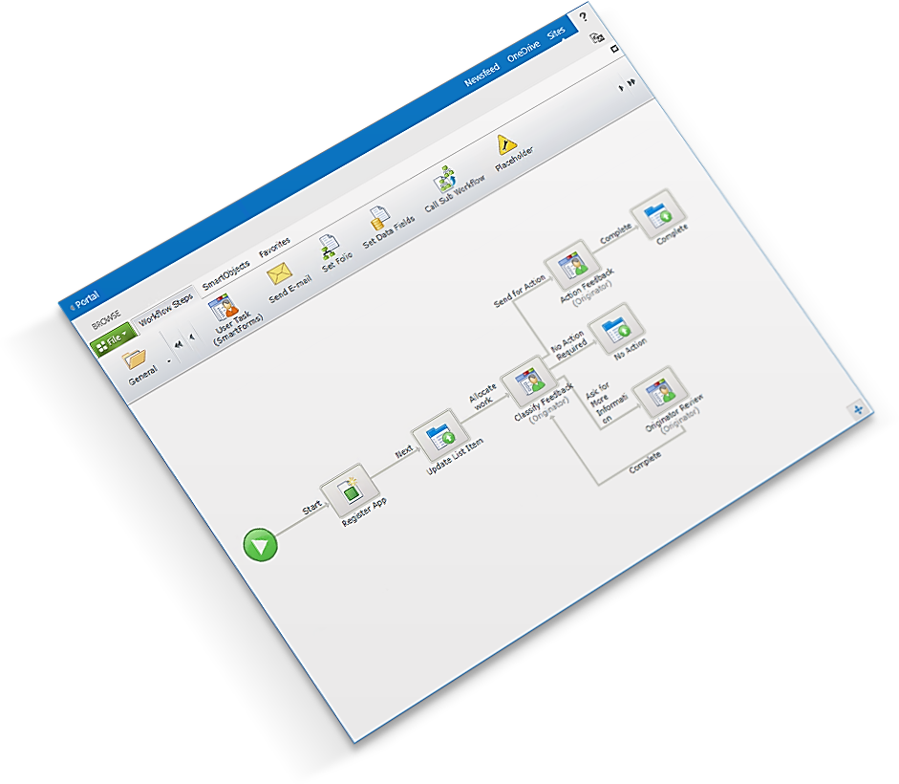
Or complex business processes that span the enterprise
Build departmental workflows consisting of a few steps
Do more with tools you know, like Word, Exchange and CRM
Notes:
K2 provides an enterprise class workflow engine with design tools that cut complexity, enable the delivery of reusable workflows and timesaving features.
Go big or go small
K2's workflow software can be used to manage simple departmental processes (then grow, if necessary)
(click) or built to meet complex needs and span the largest enterprise organisations.
Drag-and-drop design
Use drag and drop components in your preferred browser to create re-usable workflows for your business applications.
(click) Do more with tools you know Leverage your existing investments to automate work including booking meetings, creating documents, sending emails and more.

Slide 24
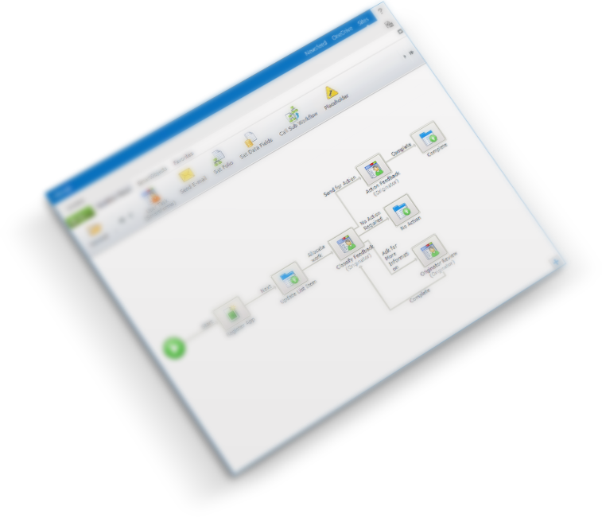
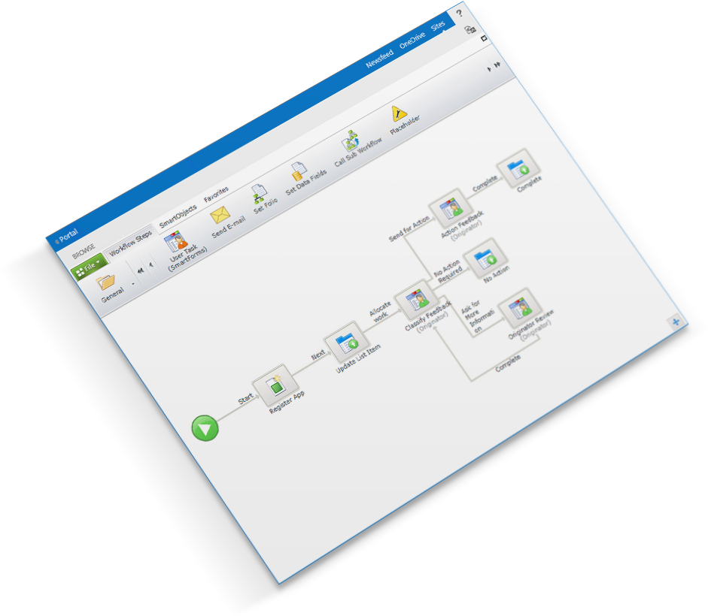
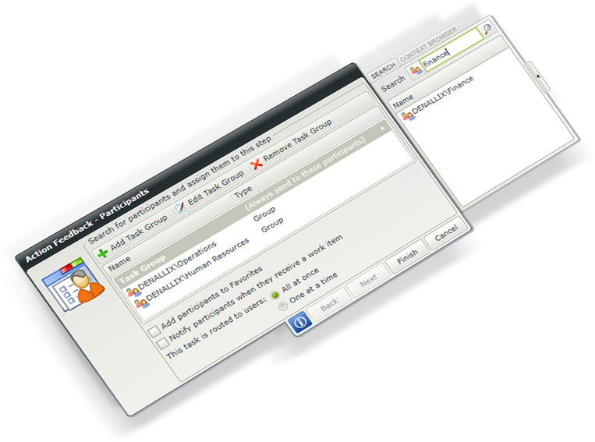
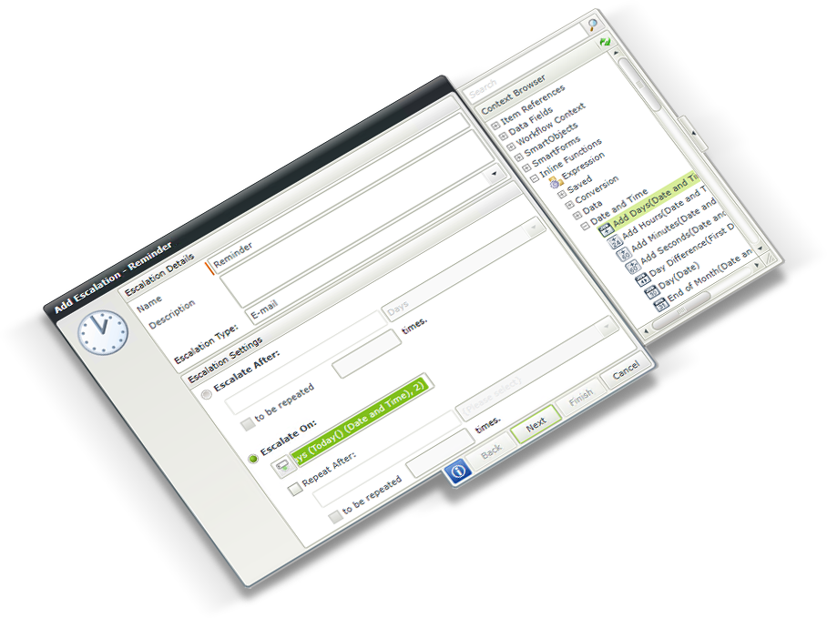
Assign tasks to multiple people, groups, roles or
based on rules
Schedule escalations based on business configuration
Notes:
Deliver workflows to the enterprise
K2 comes with an extensive feature set to help you create workflows. From basic task routing to complex solutions with policies, rules, escalations and exception handling
Task Allocation Ensure the right people get allocated work at the right time based on your business requirements
Escalations Make sure you meet your business SLA’s leverage escalation to pro-actively remind users and teams or escalate it to management if required
Inline Functions Performing calculations and functions in your workflows are done through no code wizards
Business Information Use your line of business information in your workflow without code to route your process, make decisions and update information.

Slide 25

Data: Conecta hasta con la C.I.A.

Slide 26

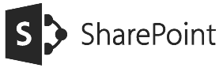
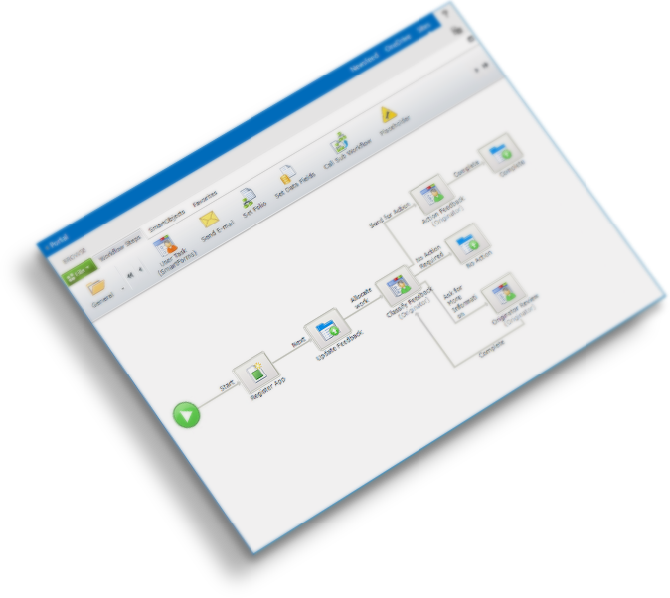
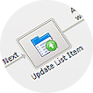

SMARTOBJECTS
CUSTOMER FEEDBACK
Title
Priority
Assigned To
ORDER
Product Name
Quantity
Value
ACCOUNT
Account Name
Contact
Rating
Notes:
K2’s patented smartobjects enable you to define the information you need to use in your applications and connect without code to your systems.
Data in forms
Use business information from multiple line of business systems in your forms to give people all the information they need in one place at the same time. Save time and effort logging in and out of multiple systems.
Data in workflow
Use line of business data to make decisions, route workflows, assign tasks to the correct teams and automate line of business systems all winthout code.

Slide 27
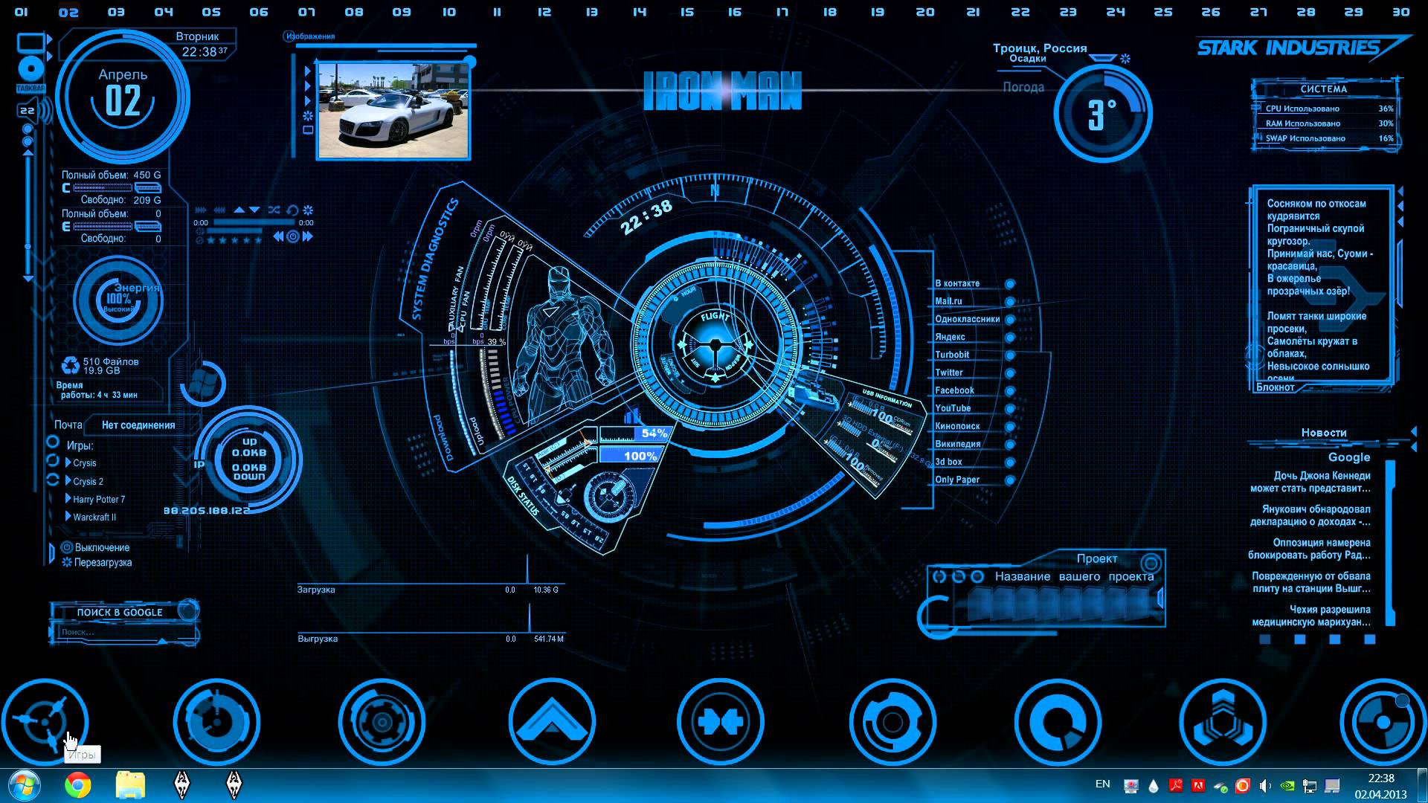
Reports: Saber pasa en cada momento

Slide 28

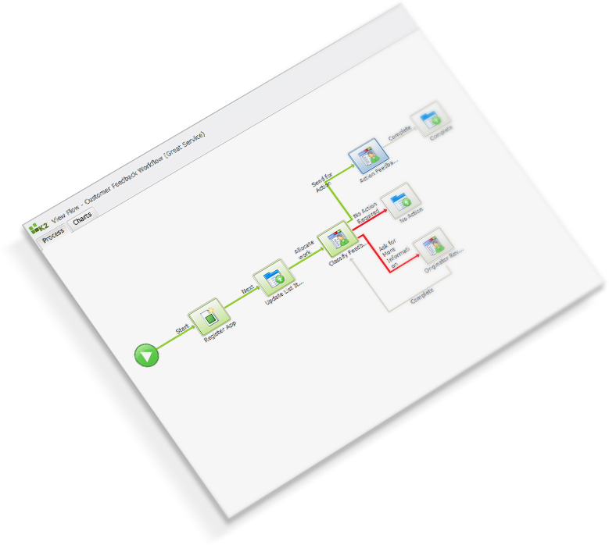
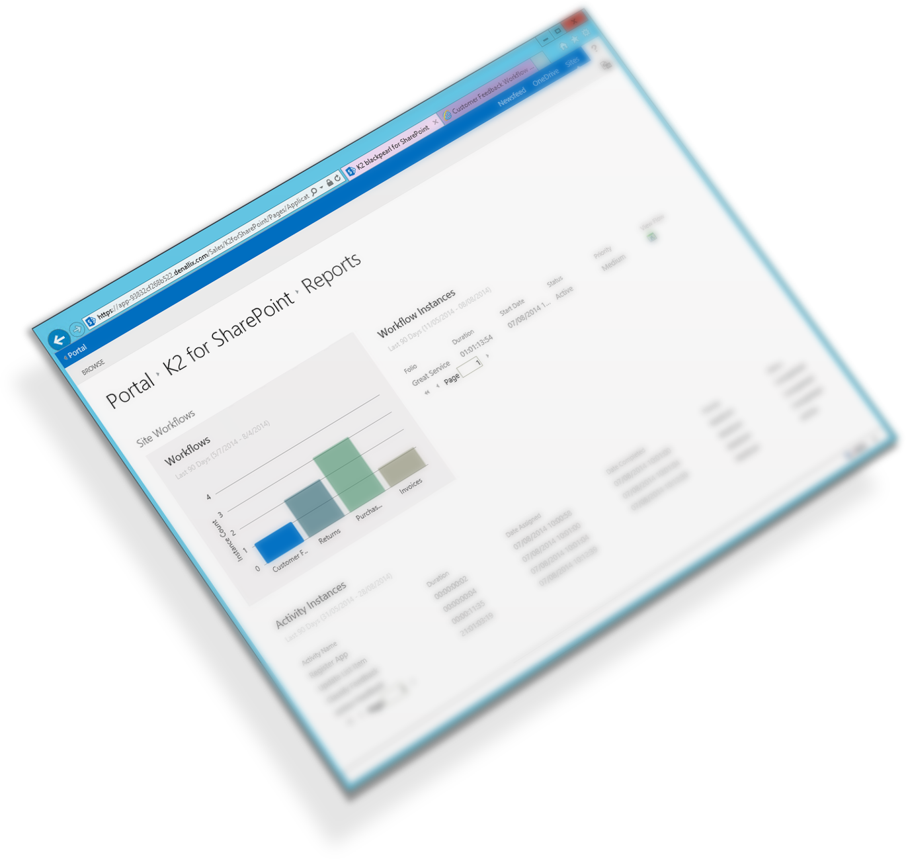
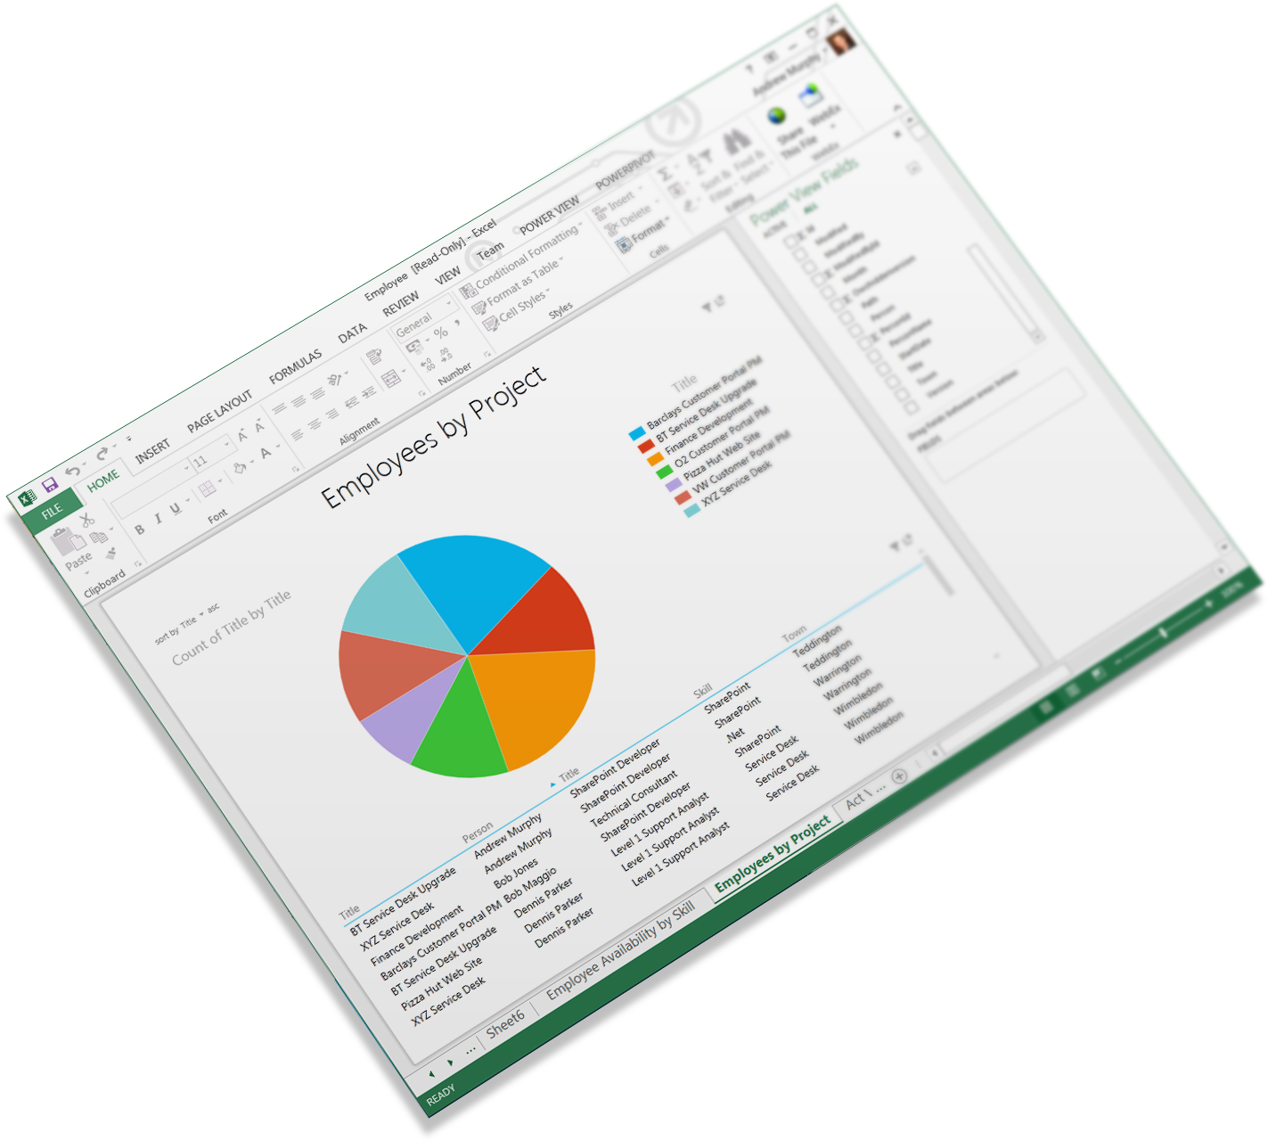
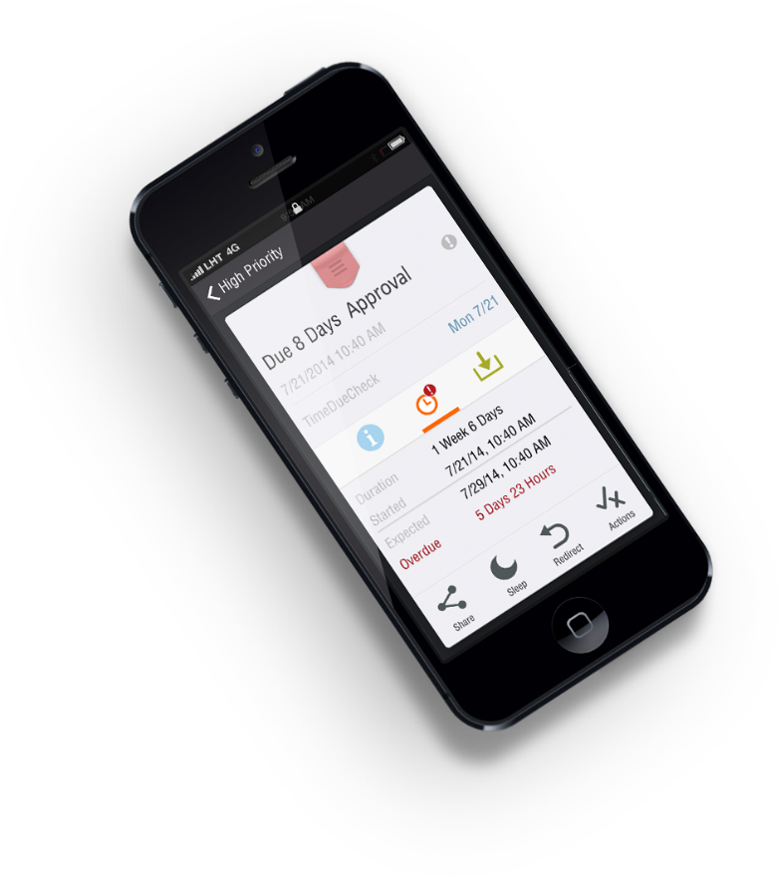
A combination of business analytics and workflow data provides real-time visibility
Out-of-the-box reporting portals
Design custom reports using industry standard tools, like Excel PowerView and SSRS
Visibility on the go
Notes:
Track your applications with real-time insight into process status and business performance.
Use out-of-the-box reports that combine business analytics and workflow data, or create custom reports and alerts based on what's important to your organization.
Monitor progress and performance
K2's real-time visibility lets you track the progress and performance of your applications and your business, so you can use up-to-the-minute data to make better decisions based on business analytics. With K2 it is obvious what is happening in your processes.
Design custom reports using industry-standard tools
People are more productive when they work in familiar environments.
K2 provides extensive integration to a number of Microsoft-based tools — Excel PowerPivot, SQL Server Reporting Services and others to make information easily accessible.
Info in real-time
K2 gives you the ability to send notifications based on guidelines defined by you.
Management may want to be alerted, for example, when a supply chain is interrupted or expenses hit 90 persent of allocated budget.

Slide 29

¡Acción!

Slide 30


Slide 31
Demo 1: Una aplicación conectada
Notes:
Salesforce: https://eu5.salesforce.com/
moisestavira@hotmail.com
dev4SLFC

Slide 32
Demo 2: Office 365 Apps
Notes:
Corporate: https://k2corp.sharepoint.com/sites/AppitDenallix/EMEADenallix/_layouts/15/start.aspx#/SitePages/Home.aspx
Home: https://denallixtechuk.sharepoint.com/sites/techspecportal/SitePages/Home.aspx
My site in office 365: https://denallixtechuk.sharepoint.com/sites/techspecportal/moises/SitePages/Home.aspx

Slide 33
Demo 3: El reto de los 5 min.
Notes:
My site on https://denallixtechuk.sharepoint.com/sites/techspecportal/moises/SitePages/Home.aspx

Slide 34
¿Preguntas?

Slide 35
¿Y ahora qué?
Pásate por nuestro stand, pide más información y llévate algún regalo
Regístrate para una prueba gratuita en www.appit.com
!Busca tu próximo reto!

Slide 36
Gracias

Slide 37
Moisés Tavira
K2
Senior Technical Specialist
http://ww.k2.com
@moituit

